Slide 1
Finding the Location of NYC’s Newest Bagel Shop
Melissa DiMaio

Slide 2
Introduction
Want to find best place to open a new bagel shop in NYC
Want shop to be close to where we live. For this project, chose Central Queens.
Want to find a neighborhood which isn’t too expensive.
Thirdly, will check how many bagel shops each neighborhood already has

Slide 3
Data Acquisition
For longitude and latitude values of New York City neighborhoods, used JSON file provided by the Applied Data Science Capstone staff at coursera.org
To define Central Queens, used the Queens neighborhood divisions on Wikipedia
For average rent prices by neighborhood in Queens, used data from RENTCafe.com
To search for nearby venues, used Foursquare API

Slide 4
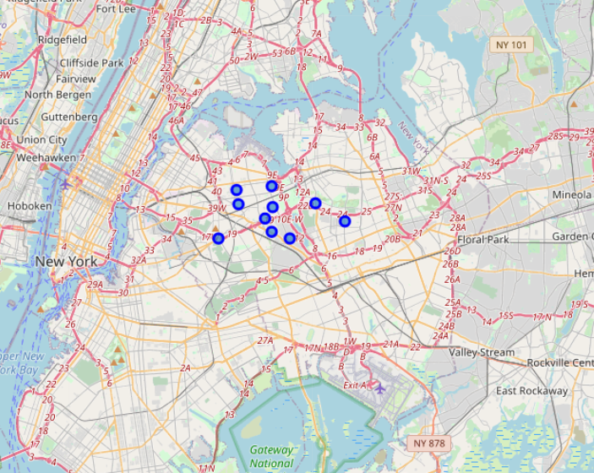
Limiting Options to Central Queens

Slide 5
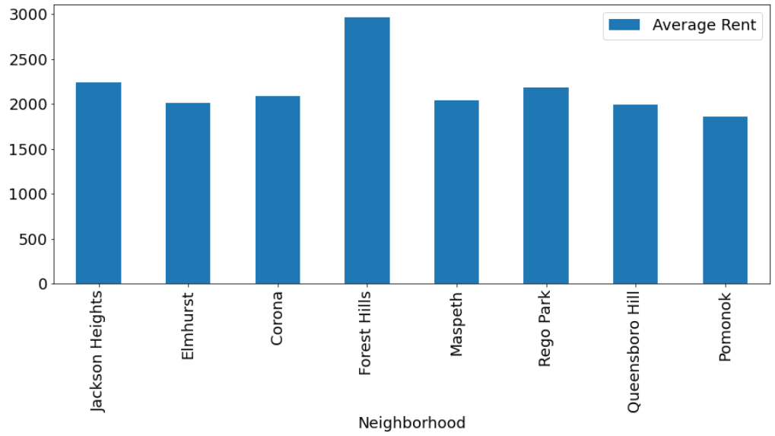
Average Rent by Neighborhood
Rent in Forest Hills is significantly higher, choose to eliminate it as an option

Slide 6
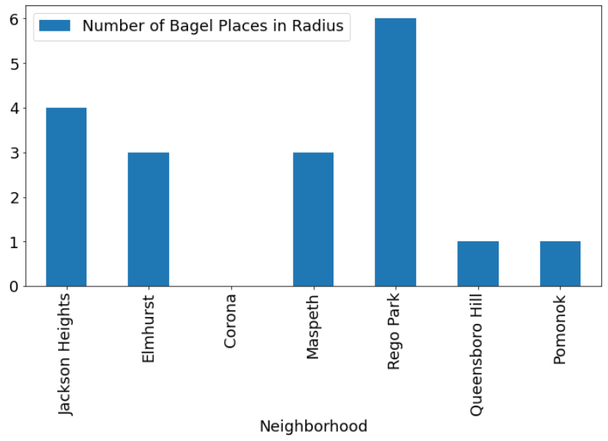
Bagel Shops by Neighborhood
More bagel shops = better place to open?

Slide 7
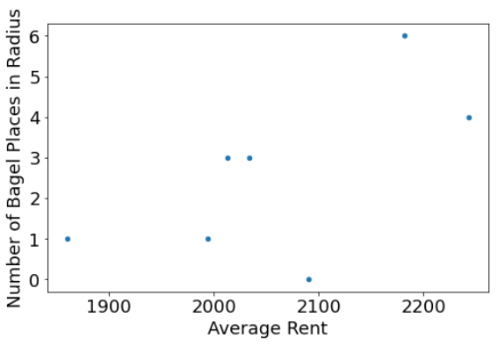
Average Rent Vs. Number of Bagel Shops
Appears positively correlated, answer won’t be so easy

Slide 8
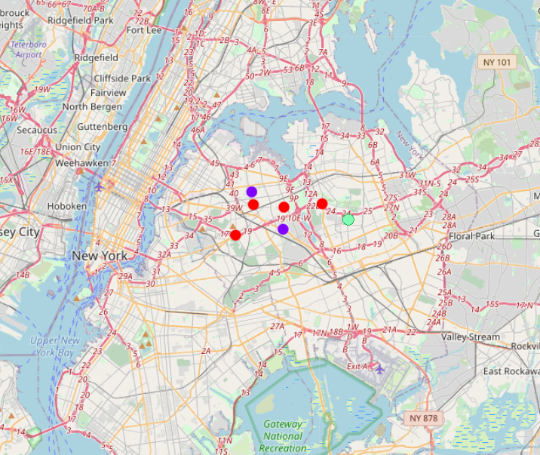
K-Means classification Model
Purple corresponds to high rent, high number of bagel shops
Red corresponds to medium rent, lower number of bagel shops
Green corresponds to lowest rent, low number of bagel shops

Slide 9
Conclusion and Future Directions
Built model which classifies potential neighborhoods into three categories to choose from
Model could be more accurate if tested on more neighborhoods
Could include other features such as
Taxes and other financial data
Reviews of nearby bagel shops
History of neighborhood

